Slide 1
State Chart Diagram
Dr. Ilavarasi

Slide 2
StateChart Diagram?
Statechart diagram is one of the five UML diagrams used to model the dynamic nature of a system.
A State chart Diagram defines the possible states of a component/ object and the transitions that cause a change in state.
Objects have behaviors and states.

Slide 3
Purpose of a StateChart Diagrams
Statechart diagrams are useful to model the reactive systems.
Statechart diagram describes the flow of control from one state to another state.
States are defined as a condition in which an object exists and it changes when some event is triggered.
The most important purpose of Statechart diagram is to model lifetime of an object from creation to termination.
Notes:
Reactive systems can be defined as a system that responds to external or internal events.

Slide 4
Statechart diagrams are also used for forward and reverse engineering of a system.
Following are the main purposes of using Statechart diagrams −
To model the dynamic aspect of a system.
To model the life time of a reactive system.
To describe different states of an object during its life time.
Define a state machine to model the states of an object.
Notes:
State machine refers to behavioral aspects of the system.

Slide 5
A simple process for statechart
Identify a class/object participating in behavior whose lifecycle is to be specified
2. identify states
3. Identify events
4. Refine and elaborate as required

Slide 6
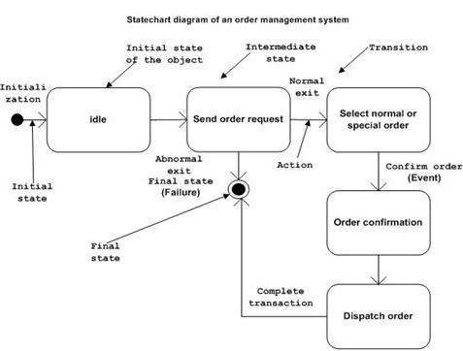
Example
Notes:
The first state is an idle state from where the process starts. The next states are arrived for events like send request, confirm request, and dispatch order. These events are responsible for the state changes of order object.
During the life cycle of an object (here order object) it goes through the following states and there may be some abnormal exits. This abnormal exit may occur due to some problem in the system. When the entire life cycle is complete, it is considered as a complete transaction

Slide 7
Summary
Statechart diagrams are used to model the dynamic aspect of a system
Statechart diagrams are used to model the states and also the events operating on the system
The practical implementation of Statechart diagram is that it is used to analyze the object states influenced by events.
Notes:
Statechart diagram defines the states of a component and these state changes are dynamic in nature. Its specific purpose is to define the state changes triggered by events. Events are internal or external factors influencing the system.

